Slide 1
Mobile Application (VCHBillings)
REFERENCE DOCUMENT

Slide 2
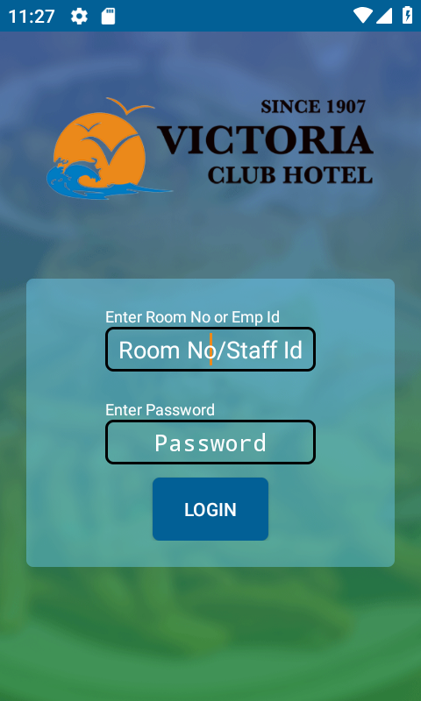
Login screen
Staffs can login using staff id and respective password
Or
Login using room no and respective password

Slide 3
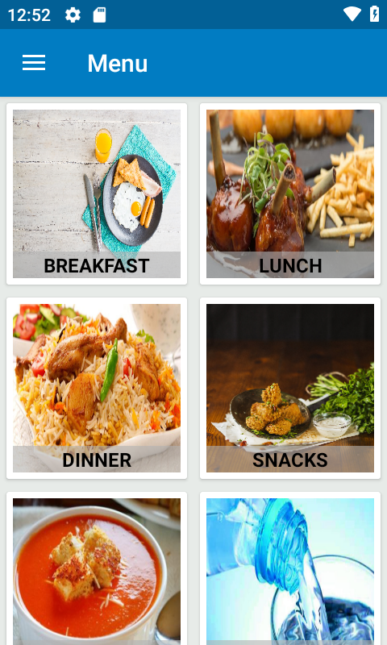
This menu screen provides user to select items from different categories

Slide 4
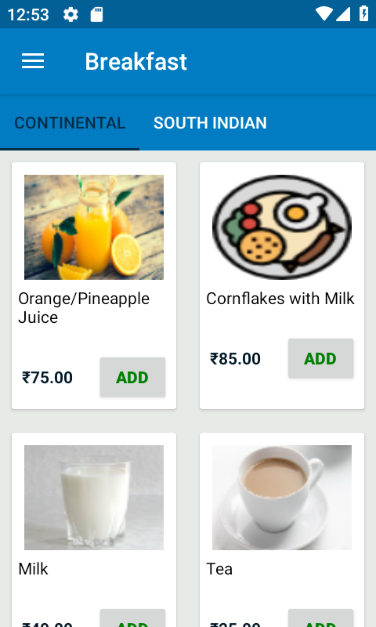
This item menu shows varieties of items available under sub menus like continental, south Indian etc.

Slide 5
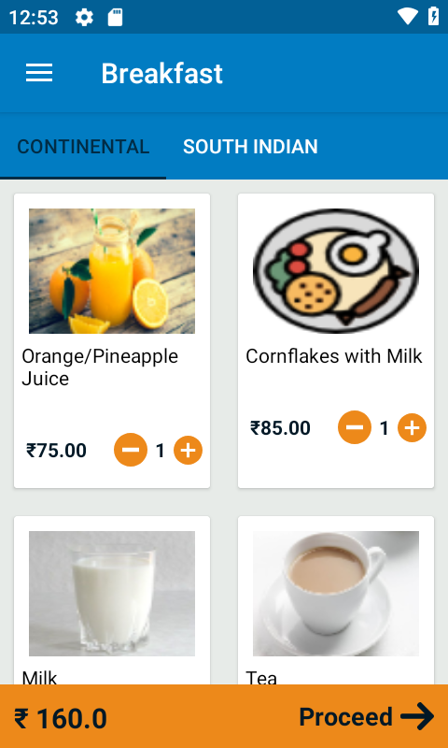
On selecting the item, it gives the option to add or remove the number of quantity
After selecting the items from menu it show the total amount it’ll cost to customer. Also gives option to proceed further

Slide 6
